Slide 1

Heart Disease Prediction
Machine Learning Approach
Demiana Abadir

Slide 2
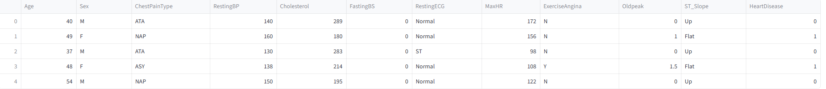
Project Objective
Heart Disease is #1 cause of death worldwide.
The goal of the project to develop a machine learning model that accurately predicts if patients have heart disease or not.
Dataset: Utilized the "Heart Disease" dataset containing 918 patient records and 12 elements.
Target Variable: HeartDisease (1 for positive, 0 for negative).

Slide 3
Data Preprocessing & Feature Engineering
Handling Missing Data: Filled missing Cholesterol values using the mean.
Feature Creation:AgeGroup: grouped ages into categories (<40, 40-55, 55-70, 70+).
Encoding: Applied one-hot encoding to all categorical features (e.g., Sex, ChestPainType, ST_Slope) to prepare them for modeling.

Slide 4
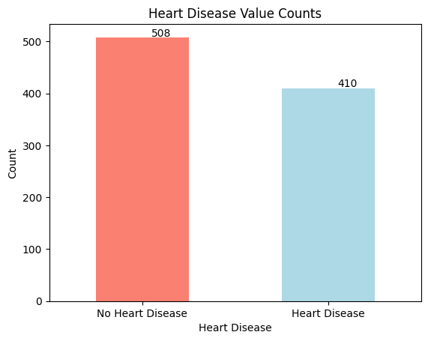
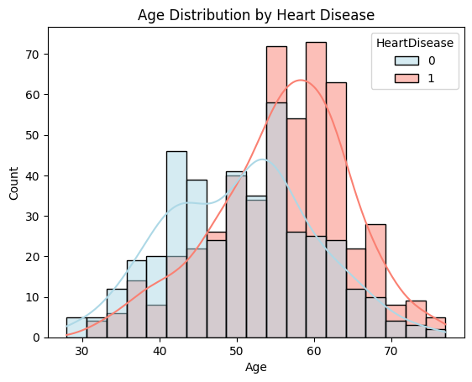
Exploratory Data Analysis
Class Distribution: The dataset is balanced between patients with and without heart disease.
Age: Heart disease is more common in older patients, particularly those over 55.

Slide 5
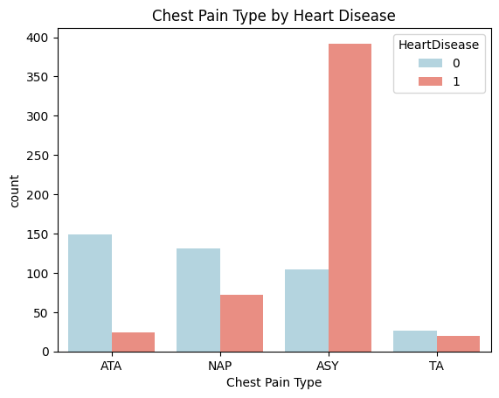
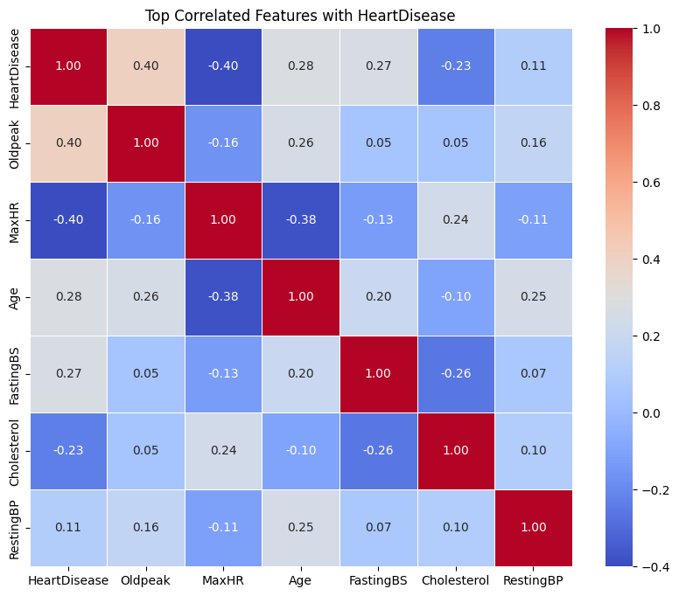
Exploratory Data Analysis
Chest Pain: Patients with Asymptomatic (ASY) chest pain have a significantly higher incidence of heart disease.
Correlation:
Oldpeak has the strongest positive correlation with HeartDisease (0.40).
Age (0.28) and FastingBS (Fasting Blood Sugar, 0.27) also show moderate positive correlations with HeartDisease.

Slide 6
Model Training & Evaluation
Approach:
Split the data into 80% for training and 20% for testing.
Trained three different classification models on the preprocessed data.
Models Used:
Decision Tree Classifier
Support Vector Classifier (SVC)
Random Forest Classifier
Evaluation Metrics:
Accuracy
Recall
F1 Score

Slide 7
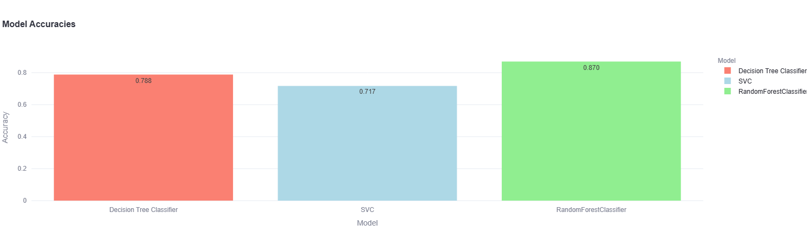
Results
The Random Forest Classifier achieved the best overall performance.

